Slide 1

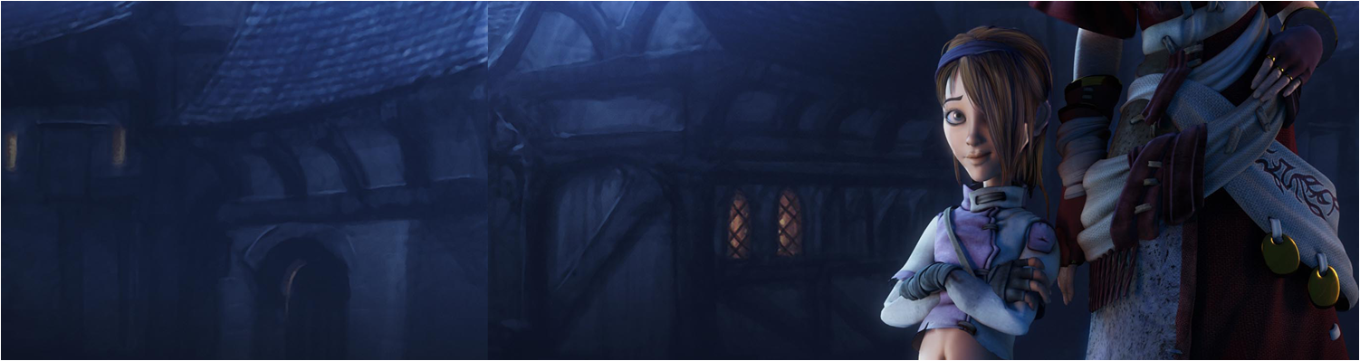

Lecture 5: FPS Games in Unity pt I
GAM150: Game Programming Essentials
BA Game Development

Slide 2
Last time:
Animating and choreographing activities
Unity UI
Prototypes into standalone games
Any issues to report?

Slide 3
Today’s session:
Assignment 2 overview
3D in Unity
Break
Prototyping with external assets
The peer review process walk-through

Slide 4
Assignment 2 overview

Slide 5
Assignment 2 overview
Your second assignment is to make a first person shooter [FPS] game in Unity
Details are on learning space
https://learningspace.falmouth.ac.uk/course/view.php?id=3095

Slide 6
Assignment 2 overview
Your second assignment is to make a first person shooter [FPS] game in Unity
Details are on learning space
Well commented and well formatted scripts, of your own devising
A Rigidbody based controller for player movement
At least two weapons
One ‘rifle’ (no projectiles, just apply instant damage to any target in line of fire)
One ‘grenade launcher’ (spawns a Rigidbody projectile which causes area-of-effect damage and applies force to all Rigidbodies in the blast radius)
One or more enemy AIs which use a finite state machine to either ‘search’ for the player (using a NavMeshAgent) or ‘attack’ if there’s line of sight (raycast). You may add any additional states if you wish (for example: ‘seek ammo’).
Baddies that respawn on death
Player that respawns on death
Some rigidbody objects to interact with (e.g. cubes and cylinders) & some scenery for cover
A wrapper consisting of a splash screen and game over screen.

Slide 7
Assignment 2 overview
Your second assignment is to make a first person shooter [FPS] game in Unity
The parts:
Rigidbody player controller [Me: week 5]
Level design [Me: week 5]
Baddie AI [Me: week 7]
Physics, weapons & spawning [Me: week 8]
Builds on what you have learnt so far:
Triggers
Audio
Animations & events
UI
Game wrapper
Stand alone game / game build

Slide 8
3D in Unity

Slide 9
3D in Unity
All the work we have done so far has been in a 2D domain
We’ll need to start using 3D projects
We need to work out new ways of:
Controlling characters
Making environments

Slide 10
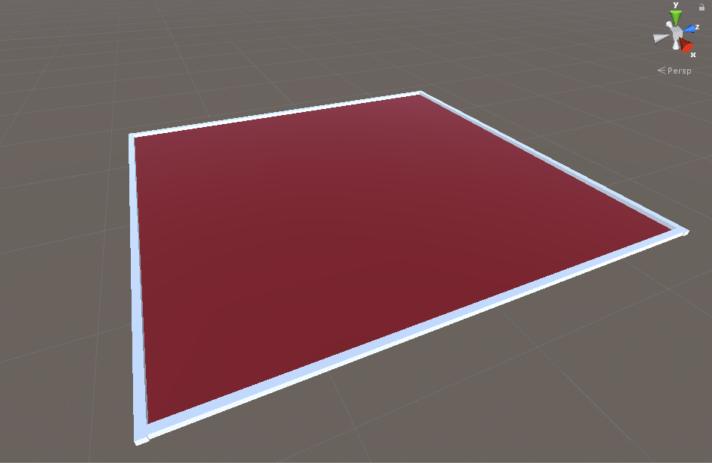
3D in Unity
For 3D (particularly experimenting with character control)
Build a level as a ground plane (at y=0)
Add a boundary to stop the player falling out / off

Slide 11
3D in Unity
For 3D (particularly experimenting with character control)
00.SimpleLevel
Build a level as a ground plane (at y=0)
Add a boundary to stop the player falling out / off
Note the axis:
X and Z form the ground plane
Y is up

Slide 12
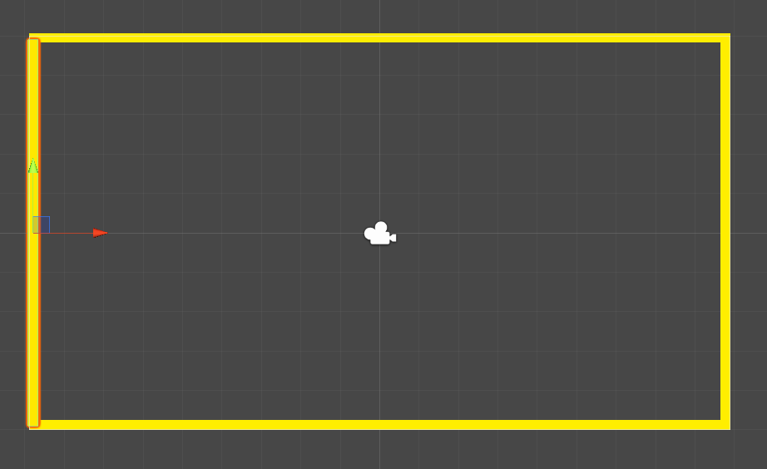
3D in Unity
For 3D (particularly experimenting with character control)
Build a level as a ground plane (at y=0)
Add a boundary to stop the player falling out / off
Exactly the same as what we did with the platformer to stop losing the player off the screen

Slide 13
3D in Unity
For 3D (particularly experimenting with character control)
You’ll also find that the standard shader will work fine in 3D
As it has a lighting model to work with
However, just like 2D, you’ll need to make copies of the ‘default-material’ to edit / change the values
Just like the 2D platformer, we can populate the 3D level with primitives

Slide 14
3D in Unity
Working with rigidbody controllers

Slide 15
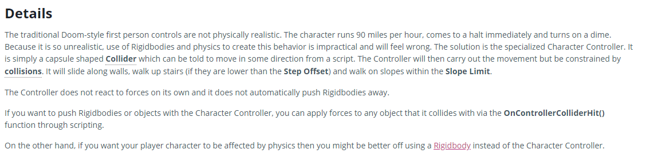
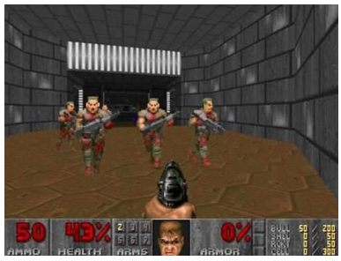
3D in Unity
Working with rigidbody controllers
In the first part of the module, we worked exclusively with character controllers
Unity has a few things to say about them
https://docs.unity3d.com/Manual/class-CharacterController.html

Slide 16
3D in Unity
Working with rigidbody controllers
A rigidbody controller will give us more ‘realistic’ control of a character and their environment
Caveats:
Uses physics to control the character
Uses physics to control the character’s interactions

Slide 17
3D in Unity
Working with rigidbody controllers
A rigidbody controller will give us more ‘realistic’ control of a character and their environment
Where physics gets cool
Objects have mass
The more mass an object has, the larger the force to make it move
Force turns into velocity once an object starts moving
When objects collide, they will share their energy
→ physical simulations

Slide 18
3D in Unity
Working with rigidbody controllers
Where physics gets cool, from a design perspective:
There is a relationship between objects in the game world, in terms of their mass & energy
This controls:
How they will move
How much they can push things
For designers (in particular) this means you need to think about this as holistic properties that will tie all the game objects in the world together

Slide 19
3D in Unity
Making rigidbody controllers
For a first person game:
Treat the player as a capsule
Add a camera to the player object to represent the ‘eyes’ of the play
i.e. It’s a view from the player’s perspective, a first person
Add a rigidbody to control how the capsule will move around the world
Create a script that will convert Input.GetAxis() to meaningful game activities

Slide 20
3D in Unity
Making rigidbody controllers
For a third person game:
Treat the player as a proper model
Add a camera to the player object to represent the ‘eyes’ of the play
Add an offset to the camera so that the player always is in scene
So it’s not a view from the player’s perspective, but from a third perspective (third person)
Add a rigidbody to control how the capsule player will move around the world
Create a script that will convert Input.GetAxis() to meaningful game activities
As you can see, first and third person controllers are very similar
All about how the camera moves relative to the player

Slide 21
3D in Unity
Making rigidbody controllers
For a first person game:
01. Simple Rigidbody Controller
Create a script that will convert Input.GetAxis() to meaningful game activities
We want the player to move like and FPS:
W&S will push the player along the direction of the camera
A&D will strafe left and right of the direction of the camera

Slide 22
3D in Unity
Making rigidbody controllers
For a first person game:
01. Simple Rigidbody Controller
Create a script that will convert Input.GetAxis() to meaningful game activities
We want the player to move like and FPS:
W&S will push the player along the direction of the camera
A&D will strafe left and right of the direction of the camera
Unity will help here with:
transform.forward
transform.right
https://docs.unity3d.com/ScriptReference/Transform-right.html

Slide 23
3D in Unity
Making rigidbody controllers
For a first person game:
Create a script that will convert Input.GetAxis() to meaningful game activities
To move the player forward or right, we need to do some physics on them
We do this by adding a force to their rigidbody components and the type of force we want to add is and Impulse (an instantaneous force)
The amount of force you need to apply will depend on the mass of the object you are moving and how fast you want it to go
Expose force into the inspector for experimentation
https://docs.unity3d.com/ScriptReference/Rigidbody.AddForce.html

Slide 24
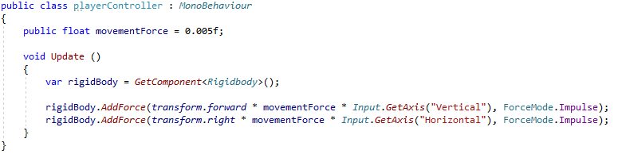
3D in Unity
Making rigidbody controllers
For a first person game:
01. Simple Rigidbody Controller
Use WSAD / arrows to move forwards & backwards and strafe
Add game objects to make the travel more obvious

Slide 25
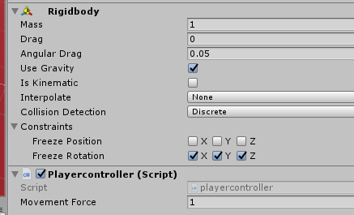
3D in Unity
Making rigidbody controllers
For a first person game:
01. Simple Rigidbody Controller
Select the player in the scene while the game is running
Observe:
Forward and backward is down the blue (Z) axis
Strafing is down the red (X) axis
NB
When you start writing your own, make sure that all the rotation axes are frozen in (rigidbody->constraints)

Slide 26
3D in Unity
Making rigidbody controllers
For a first person game:
Mouse Look At control
We want the mouse to control what the player is looking at
And, we want the player to move based on what they are looking at

Slide 27
3D in Unity
Making rigidbody controllers
For a first person game:
Mouse Look At control
02.Horizontal Look At
Use the mouse X-axis to control the horizontal input to the player’s facing direction
As this is going to adjust rotation in the X/Z plane (floor) we will adjust the Y component of the rotation

Slide 28
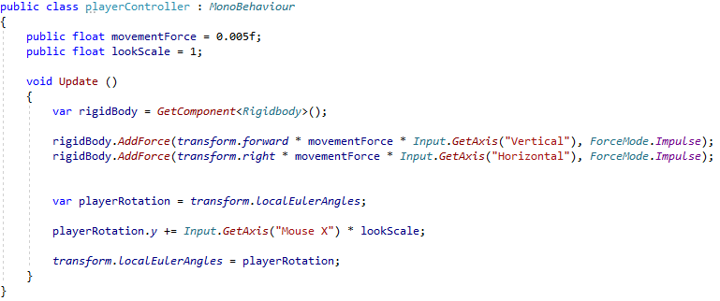
3D in Unity
Making rigidbody controllers
For a first person game:
Mouse Look At control
02.Horizontal Look At
Add lookScale to make the mouse move quicker or slower

Slide 29
3D in Unity
Making rigidbody controllers
For a first person game:
Mouse Look At control
03.Vertical Look At
Make the camera respect player elevation changes (with mouse Y).
Can’t apply this directly to the player as they’ll just lean backwards and forwards
Apply to the camera instead

Slide 30
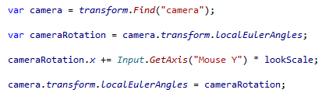
3D in Unity
Making rigidbody controllers
For a first person game:
Mouse Look At control
03.Vertical Look At
However, camera elevation is a bit odd
Need more control over max and min values for elevation

Slide 31
3D in Unity
Making rigidbody controllers
For a first person game:
Mouse Look At control
04.Vertical Look At
Capture the max and min values you want for camera elevation
Can do it with UI debug printing to see things more easily
Note the value and sense of camera rotations
This ties into what we looked at with spinning UI components last week
The values that come out of Unity are not always what you expect ;)

Slide 32
3D in Unity
Making rigidbody controllers
For a first person game:
Mouse Look At control
04.Vertical Look At
For the camera, ahead level is 0 degrees, and increases as you rotate towards the floor
Rotation in games can be difficult due to the 359/0 crossing
We know a circle has 360 degrees
And it wraps from 359 back to zero
We want valid angles to be > 330 AND < 30
So we need to work out which part of the circle the angle is in and make the logic work accordingly

Slide 33
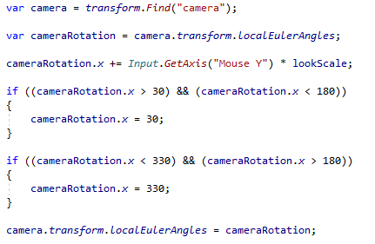
3D in Unity
Making rigidbody controllers
For a first person game:
Mouse Look At control
04.Vertical Look At
270
330
180
0
30
90

Slide 34
3D in Unity
Making rigidbody controllers
For a first person game:
Mouse Look At control
04.Vertical Look At
Feel free to:
Change the values to limits you prefer
Invert look at
Change the lookScale to make it faster / slower
Use different lookScales for X & Y

Slide 35
3D in Unity
Making rigidbody controllers
For a first person game:
Mouse Look At control
05.Mouse Control
One thing that is particularly annoying with Unity is that once you use the mouse to drive player input, it’s really hard to use the editor in Unity
and you can often get spurious things happening when the mouse goes into another window and you left click
Let’s stop this!

Slide 36
3D in Unity
Making rigidbody controllers
For a first person game:
Mouse Look At control
05.Mouse Control
We can use Cursor.LockState to control how the mouse works
The escape key will toggle between CursorLockMode.Locked and CursorLockMode.None
CursorLockMode.Locked will hide the mouse and disable it from moving
CursorLockMode.None wont
So, when you want to debug your app, press the escape key and the mouse will come back
Press it again, and it will disappear (may take some time)

Slide 37
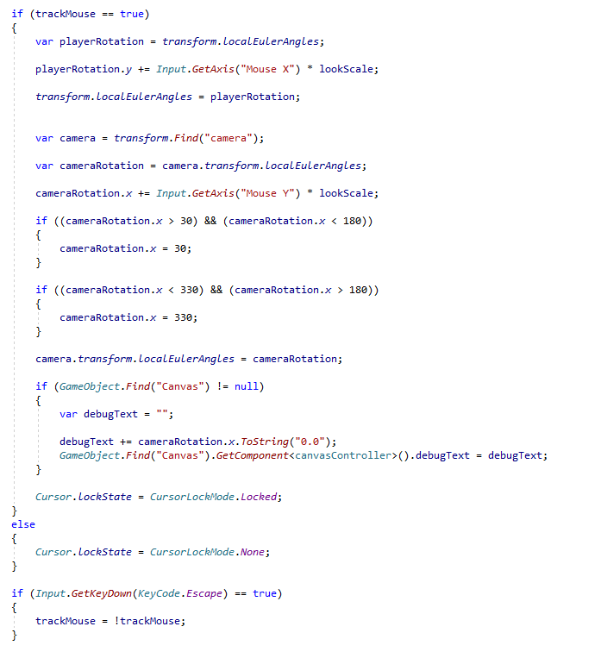
3D in Unity
Making rigidbody controllers
For a first person game:
Mouse Look At control
05.Mouse Control

Slide 38
3D in Unity
Making rigidbody controllers
We now have a fairly robust rigidbody controller
Feel free to experiment with it:
Change the physical properties (Rigidbody.mass & movementForce)
Change the LookAt properties (lookScale, control inversion, lookat limits etc)

Slide 39
3D in Unity
Making environments

Slide 40
3D in Unity
Making environments
We’ve seen that we can use Unity prims to make environments
We can also use Probuilder to sculpt
Get Probuilder from the asset store and import into a project
https://assetstore.unity.com/packages/tools/modeling/probuilder-111418
I’m no sculptor, so here’s a short video on Probuilder
https://www.youtube.com/watch?v=PUSOg5YEflM

Slide 41
Break

Slide 42
Prototyping with external assets

Slide 43
Prototyping with external assets
Unity and Probuilder have shown us ways of building level content within Unity
What if we want to use external resources?
Like artists
Like other assets on the asset store

Slide 44
Prototyping with external assets
Maya
Maya is an industry-standard modelling package
We use it in the Academy for the art and animation courses and pathways
Installed on all the machines
Available as a free student application
https://www.autodesk.com/education/free-software/maya
Set up an account and install on your own pc / laptop
Has some commercial restrictions

Slide 45
Prototyping with external assets
Maya
As developers, you will end up importing Maya created assets into your games
As designers it’s useful to be able to rough out levels for game play
This process is known as greyboxing
Create the form of levels to drive the function
Use default (grey) materials
Designers refine levels for gameplay
Pass levels to artists for aesthetic / material pass

Slide 46
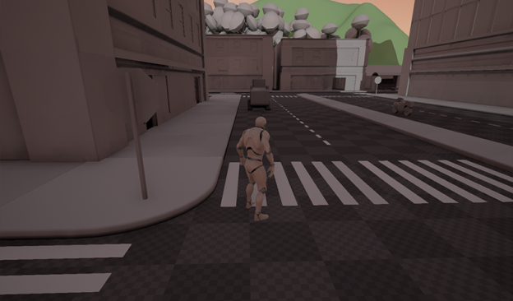
Prototyping with external assets
Maya
As developers, you will end up importing Maya created assets into your games

Slide 47
Prototyping with external assets
Maya
As developers, you will end up importing Maya created assets into your games
As programmers it’s super important to be able to get art assets into a game & deal with issues
Generally, artists often struggle with technical issues & programmers need to support artists
It’s common for assets to turn up in Unity:
Wrong size / scale, wrong orientation, wrong textures, wrong names, wrong whatever ....
So, having an understanding of how Maya works, issues you can run into and how to fix them is of great value ...

Slide 48
Prototyping with external assets
Maya
Load up Maya
Make some assets
Can create assets from the Poly Modelling shelf
Objects are created at the origin
Can use scale, rotate & move icons on left of screen to manipulate (just like Unity)
Can name also them

Slide 49
Prototyping with external assets
Maya
Load up Maya
Export to fbx
File->Export All as FBX Export
Set geom to triangulate
Can also export to unity

Slide 50
Prototyping with external assets
Maya
In Unity
Drop fbx in assets folder
In inspector->model
Set scale factor to make it the ‘right’ size
Generate colliders if you need them
[windows->analysis->physics debugger]
Turn on collision geometry to see the colliders
Once the model is in Unity, you can apply new materials and duplicate & manipulate components in the hierarchy

Slide 51
Prototyping with external assets
Asset store assets
You’ve all seen the asset store (Jamie’s assets & Probuilder)
Can be a really useful resource for content
Particularly things that aren’t essential to your game
Background content
Assets for prototyping
Assets to deconstruct and learn techniques from
etc

Slide 52
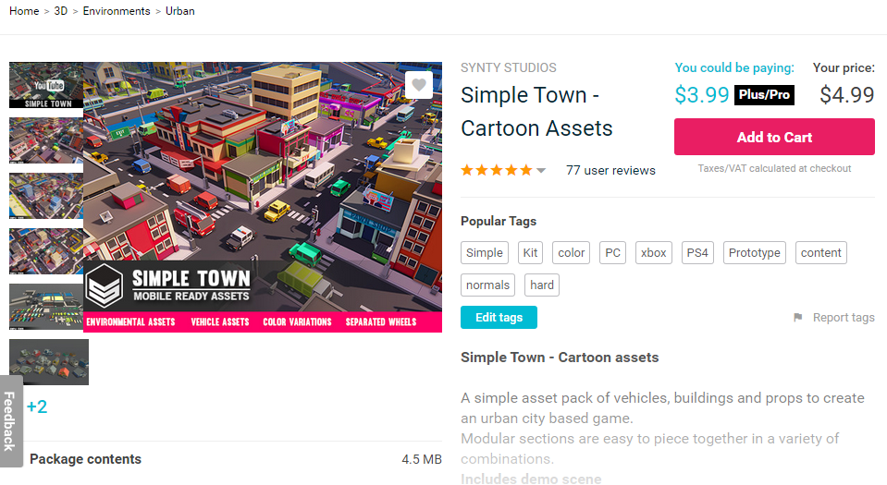
Prototyping with external assets
Asset store assets
An example

Slide 53
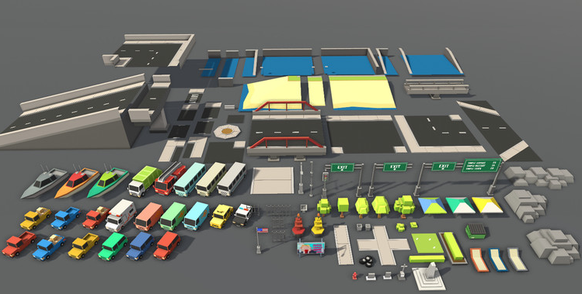
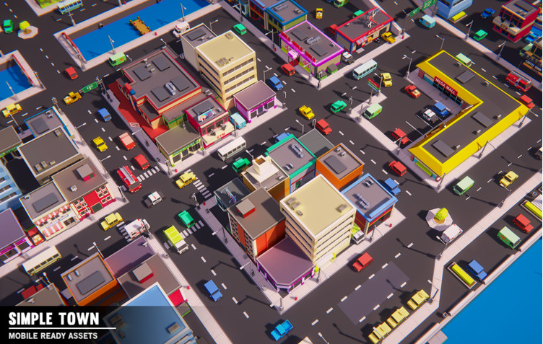
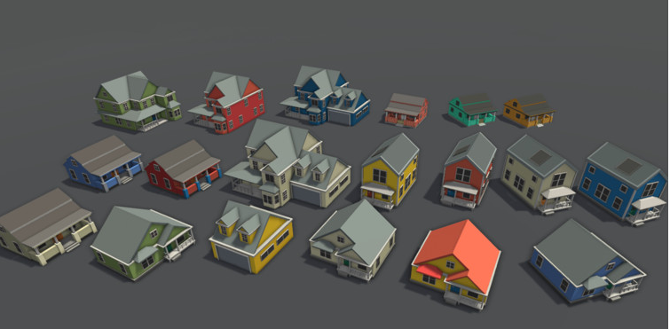
Prototyping with external assets
Asset store assets
An example
I wanted some assets for experimenting with 3D scenes
This was cheap, had lots of stuff and was modular
And had a pre-build city

Slide 54
Prototyping with external assets
Asset store assets
07. Simpletown Raw
Download the asset
Extract the level into a prefab
Add to my testbed
Run ...

Slide 55
Prototyping with external assets
Asset store assets
An example
Ok, player falls through world
Why is this, use the physics debug view
[windows->analysis->physics debugger]
Nothing comes up
There’s no colliders for the assets ☹

Slide 56
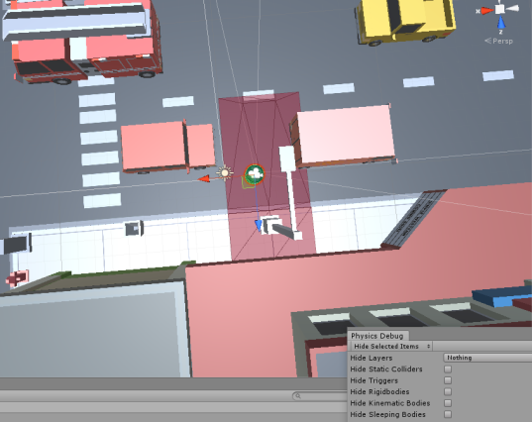
Prototyping with external assets
Asset store assets
An example
Ok, player falls through world
Why is this, use the physics debug view
[windows->analysis->physics debugger]
Nothing comes up
There’s no colliders for the assets ☹
Test this:
Pick the mesh under the player and add a mesh collider

Slide 57
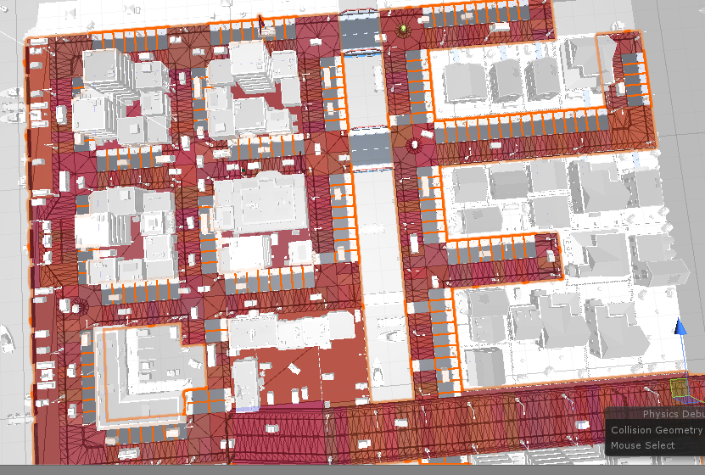
Prototyping with external assets
Asset store assets
An example
Select all the assets and add colliders to them
Do in groups to make it easier
Not everything is physics because some meshes use –scale to mirror -> bad
Need to manually fix

Slide 58
Prototyping with external assets
Asset store assets
An example
So, we can see this wasn’t 100% successful
Only really took a bit of tinkering / fixing to make it work for my needs
It’s much nicer than going around world of cubes ;)
However, the asset store has the potential to give you a lot of bang for your buck
Bit of caveat emptor (buyer beware)
& an ideal opportunity to learn about what can go wrong with unity assets and components

Slide 59
Prototyping with external assets
Asset store assets
08.Simpletown
These problems can be fixed
Simpletown now gives us an environment to experiment in
Remove the vehicles to increase play space
Add content to increase town layout
Start adding gameplay
Create your own town blocks
Make the cars players
etc

Slide 60
Prototyping with external assets
Different assets, different needs and issues
 | Positives | Negatives
Unity Prims | Easy to work with Quick to block out spaces & link to scripts | Limited assets (Can be) hard to make look good Can’t export to art packages
Pro Builder | Richer set of prims Can export to Maya Quick to block out spaces & link to scripts | (Can be) hard to work with (Still) limited assets
Maya | Good for artists Export to Unity | Hard for others to work with (Can be) hard to link to scripts
Asset Store | Lots of content Scope to export to Maya | May not meet your aesthetics Can be hard to rework Challenge to find exactly what you want

Slide 61
The peer review process walk-through

Slide 62
The peer review process walk-through
Peer review session is first lecture after reading week
Before the assignment hand-in
Review is 9/11
The idea is that you can use peer review feedback to refine your submission before handing in
And develop constructive criticism skills
Peer review is compulsory and you will fail the assignment if:
You don’t submit a submission for peer review
You don’t attend the peer review
Your reviews aren’t any good

Slide 63
The peer review process walk-through
Here’s how it works
Before the review
Submit your work to the peer review
Submit your game as a standalone build in a zip file
Make sure it works before and after you zip it up
At the review
When the review starts, I’ll start up the review process and you will be randomly assigned submissions to review
Unzip the file and play the game
Assess the game based on the assignment criteria and submit your write up
Do the next submission until you are done

Slide 64
The peer review process walk-through
Here’s how it works
At the end
Once everyone is done, I’ll finalise the review process. We can all have a tea break and your submission feedback will be available for you to read and act on before you submit your final assignment
The rest of the session will be a workshop on AI

Slide 65
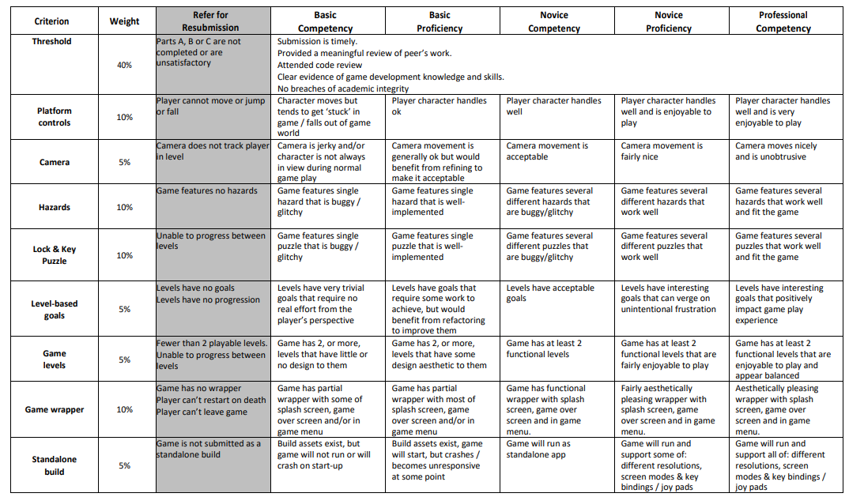
The peer review process walk-through
Here’s how it works
Doing Reviews
Be civil in your reviews
Use the assignment marking guide as a guide
Highlight any obvious bugs and issues you find
8 sections -> 8 sentences

Slide 66
Questions?

